Slide 1
The language of advertising

Slide 2
The main intentions of our research
The goal is to scientifically understand and to describe linguistic, communicative, pragmatic and stylistic peculiarities of the English advertising texts;
The theoretical importance is the combined application of different approaches to detect the systematic character of the means, belonging to the different linguistic levels;
The practical importance is determined by the opportunity to use its results in the educational process.

Slide 3
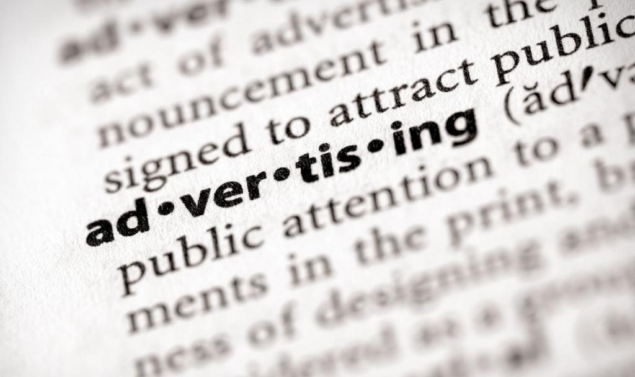

Slide 4
The social importance of the advertisements
This is advertisement that constantly influences the mentality of the majority if the Earth population, which results not only in formation of purchasing preferences, but also determines certain thinking standards, as well as create the behavior of certain social classes all around the world.

Slide 5
Structural and semantic peculiarities of the advertising texts
An advertising text belongs to non-traditional type;
The textual information can be represented with a rhyme inversion, special emphases, graphic ways of designation;
The essence of a sentence is expressed with: form of a statement, supposition and expectation;
It combines the features of other levels’ signs: iconic signs, index signs and symbols.

Slide 6
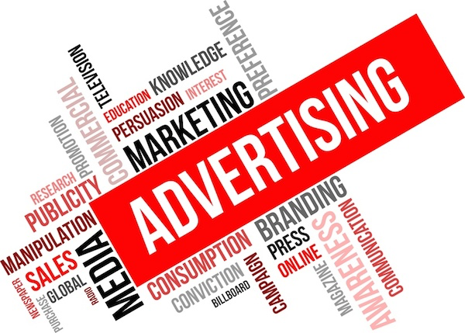
Influencing tools for advertising

Slide 7
Influencing tools for advertising
Metonymy is widespread in advertising headlines as a capacious expressive and figurative means. Another important method is synecdoche – a type of metonymy, which is based on transference a word meaning from one phenomena to another one according to the quantitative relations. Usually synecdoche uses: 1) single instead of multitude; 2) multitude instead of single; 3) a part instead of whole; 4) genetic name instead of type one; 5) a type name instead of genetic one:

Slide 8

Influencing tools for advertising
Epithet is a stylistic figure, being a definition or an adverbal modifier in a sentence as an attribute of an object, an action or a state, is characterized with high emotional and expressive capacity, judgement and figurativeness. Epithets are rather favorable for advertisers, as they help to make reasons more lively and demonstrative:

Slide 9
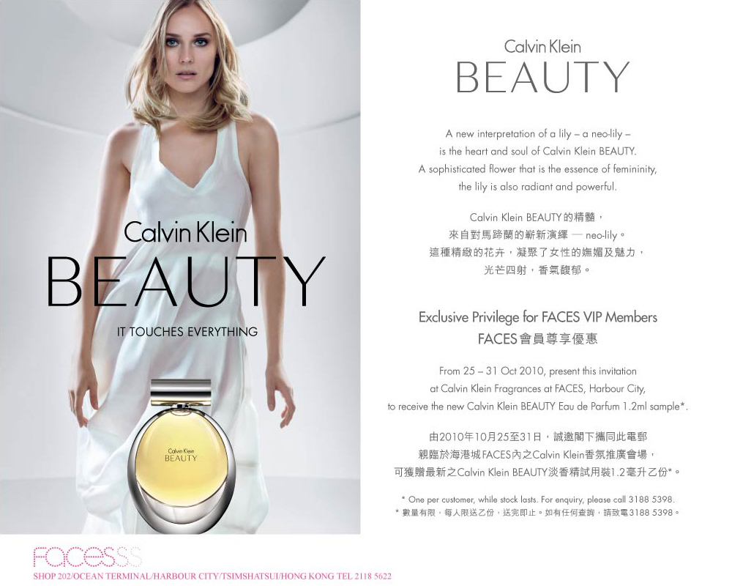
Influencing tools for advertising
Hyperbola is a word construction, where the features of a described object are presented in the exaggerated form aiming in attracting readers’ attention at them. Manufacturers use this stylistic tool in order to demonstrate their products in the most favorable way :

Slide 10
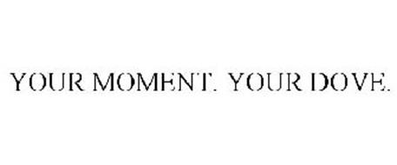
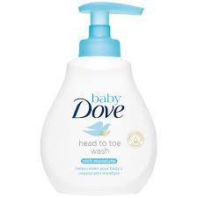
Influencing tools for advertising
Anaphora and all its types are often used in advertising headlines. The reason is that the first parts of a headline are memorized better, while anaphora encourages this process. Usually such anaphora texts contain the name of a brand, a product or service etc. This stylistic figure is aimed in emphasizing the advertised product, direct the audience’s attention at it:

Slide 11
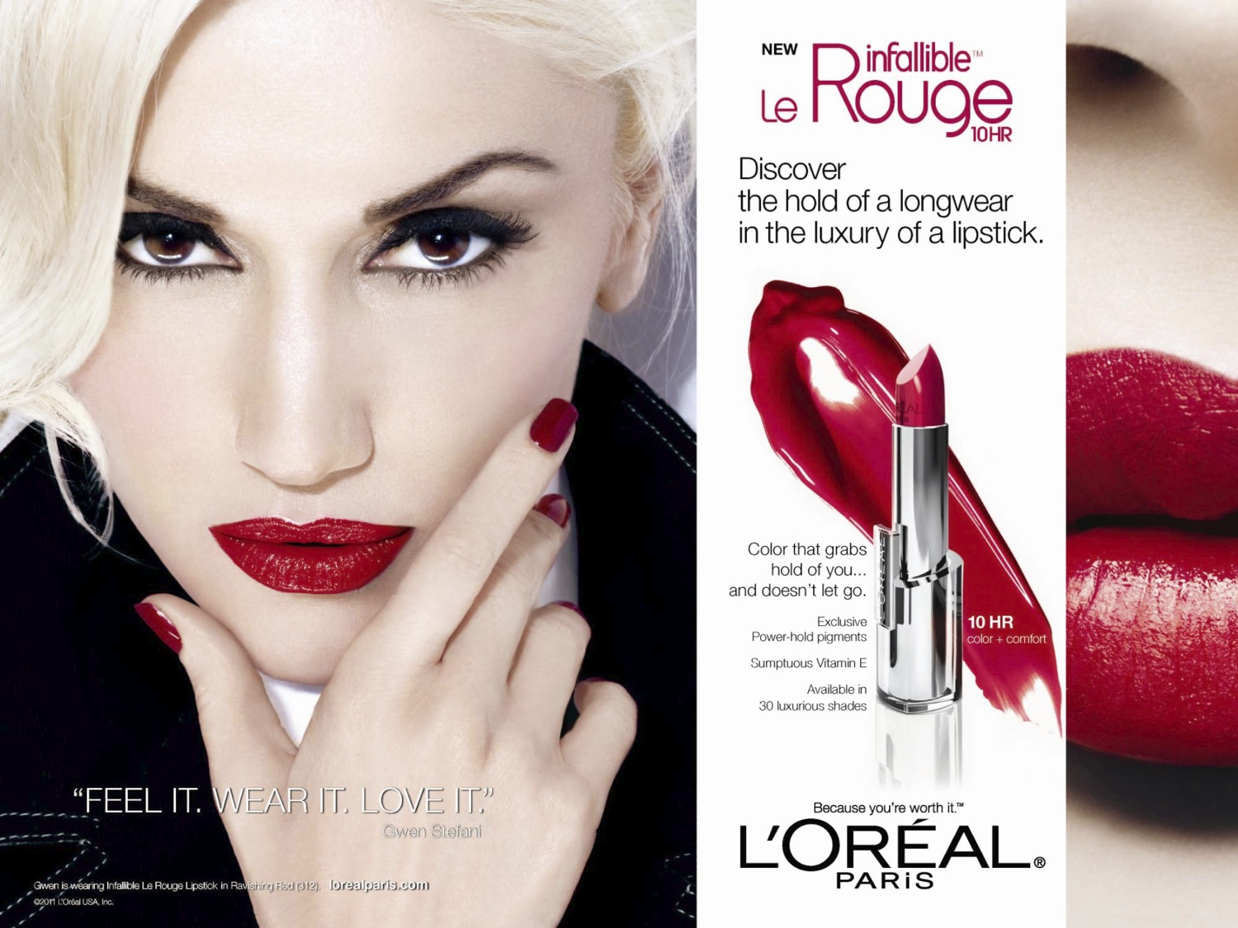
Influencing tools for advertising
Epiphora is a stylistic figure, which is the opposite of anaphora. It is created by repetition of “certain words or collocations at the end of the closely connected linguistic units”:

Slide 12
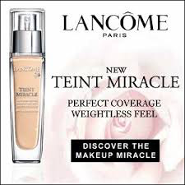
Influencing tools for advertising
Syntactic parallelism is usually full of word repetitions (anaphora, epiphora etc.) and the repetition of prepositions and conjunctions (multiconjunction). Parallel constructions have equal semantic significance. As for advertising headlines, it is possible to observe the opposite tendency in case of conjunctions – they are purposefully omitted to make a headline compact and rhythmic:

Slide 13
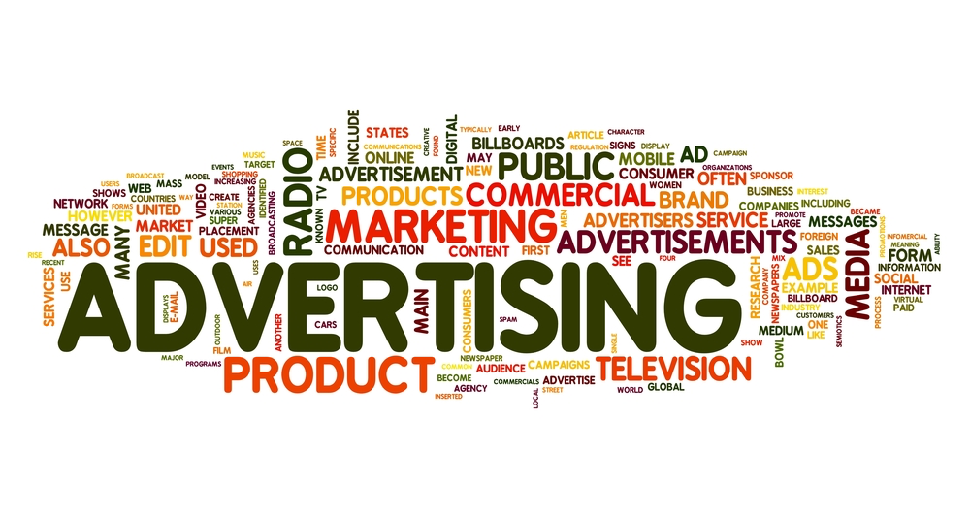
Influencing tools for advertising
Analysis of advertising texts, sampled from printed and electronic English issues, demonstrates universal regularity of using different linguistic levels’ units, which enable the work of the recipient’s imagination and memory. That is why in advertising texts almost every linguistic unit is not only semantically significant, but also possess a special communicative power. Success of an advertisement depends on its linguistic embodiment, while its effectiveness depends on three components: sound, word and sentence.

Slide 14

Conclusion
This analysis of the English advertising texts has detected exclusively positive communicative and pragmatic orientation of these texts. This feature determines the choice of linguistic means, increasing the pragmatic influence on the recipient.

Slide 15


Slide 16
Conclusion
The most effective advertising texts are those, which are equally directed at the addressee’s thoughts, feelings, attitudes and behavior. Increase in suggestive impact of advertising text is determined by its implicit character, avoiding the consciousness threshold and influencing the recipient’s unconscious sphere directly; correct choice of vocabulary on the basis of the advertising communication idea; positive connotation of advertising texts, which is reached by humor and positive vocabulary.

Slide 17

Thank you!

